Slide 1

Punk’D

Slide 2
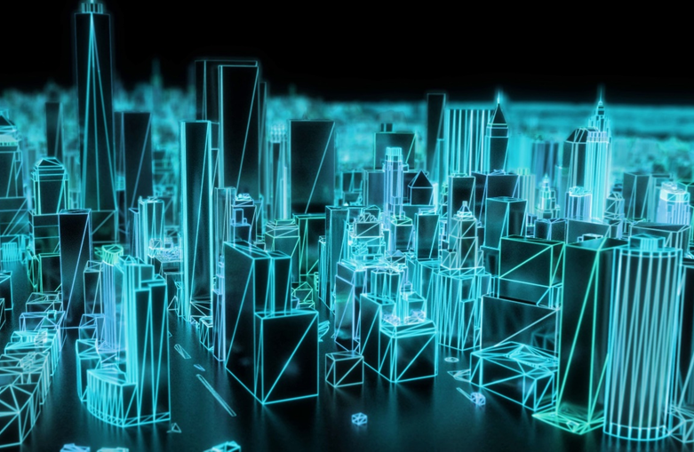
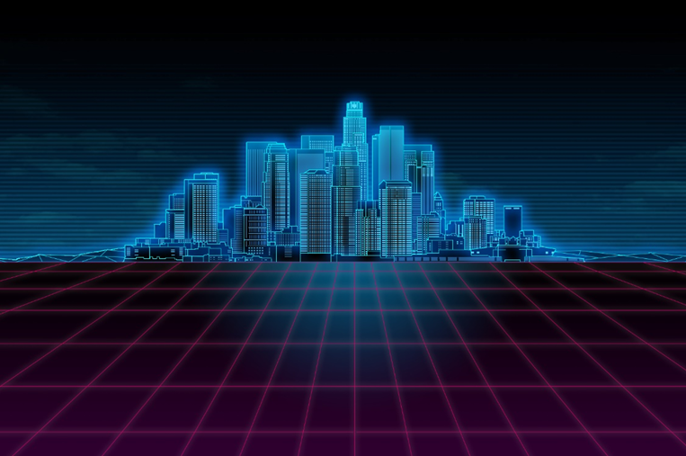

Design Ideas: Environment
Neon backdrop
Wireframe buildings
Overarching narrator that comments on the players actions (Similar to the Stanley Parable)

Slide 3

Design ideas: Mechanics
10, 3-way crossroads each with a different pun choice
Failure to choose the best Pun results in the player getting Punk’d (either immediate game over or certain number of strikes)
1 path has the best pun, 1 path has the middle of the road choice (strike but not a failure) and the final path has the worst pun which results in the player instantly failing.

Slide 4
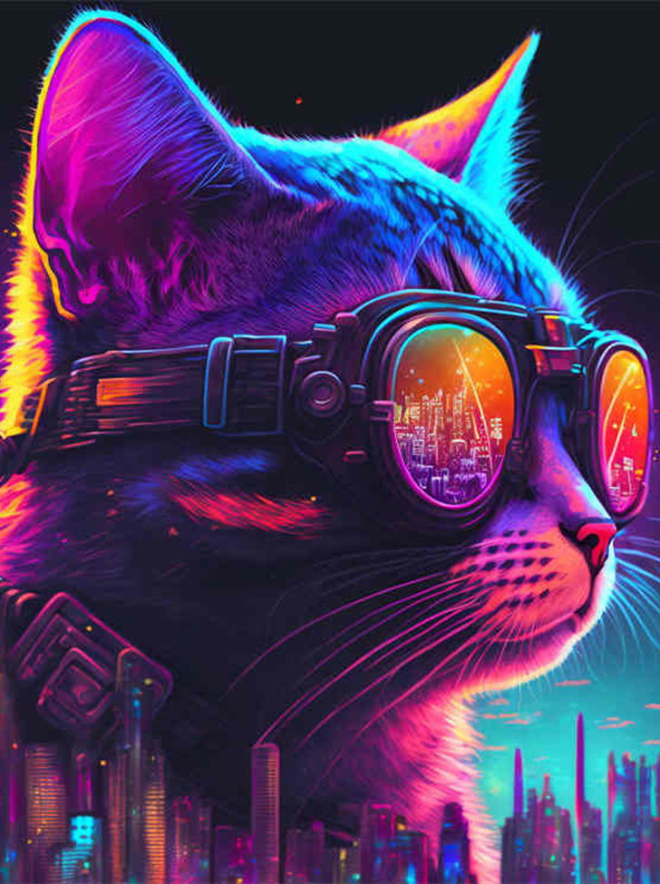
Silly thematic things
Jiggling / physics enabled punk chasing you through the level: DONE!
Jiggling / Physics enabled First person character: In-Progress

